Slide 1



Black Codher Bootcamp
Copyright © 2020 Black Codher Bootcamp. All Rights Reserved. Do Not Redistribute.

Slide 2
UNIT 2 HTML & CSS
Copyright © 2020 Black Codher Bootcamp. All Rights Reserved. Do Not Redistribute.

Slide 3
SESSION 3
*Preview Time*
Copyright © 2020 Black Codher Bootcamp. All Rights Reserved. Do Not Redistribute.

Slide 4

Recap: What we learnt last week
Tags, elements, declarations, properties, property values, content, comments, browser compatibility
Layout:<!DOCTYPE html>, <html lang>, <head> for non visual e.g. metadata, <meta charset>, <title>
External CSS <link rel>, internal/embedded, inline style +3 simple selectors: element/name; ID & class;
Responsive web design with <viewport>, universal selector (and many more), {indentation}, nesting;
Semantic web, <body> for visuals: <header>, <footer>, <nav>, <main>, <section> (and many more)
Hierarchy heading up and down <h1> - <h6>, <p>aragraph, <br>, <a href>nchor link, states e.g. pseudo
Non semantic block level containers e.g. <div>, and inline ones like <span> (and many more)shorthand
Formatting <strong> and for <em>phasis vs <b> and <i> and inserting <img>, <audio>, <video>s
Security, accessibility, testing, standards, documentation, style guides, SEO, c.theory, design thinking
GUI + CLI, Git commands e.g. git init, git status, git add, git commit, git remote, push to GitHub
P.S. Don’t forget your cheat sheets and our best friend Google!

Slide 5
Learning objectives
Learn advanced CSS concepts
Learn how CSS Flexbox works
Learn how CSS Grids work

Slide 6



At peace with ancestral inheritance or fearing family feud?

Slide 7

Combinators
Combinators are used to select the CSS we want to change: they work by combining selectors.
The descendant combinator ( ) selector chooses all speciﬁed descendants of an element: grandkids too.
The child combinator > selector chooses only the direct children.
There are also sibling combinator selectors: general and adjacent ones.
The general sibling combinator ~ selects all elements that are siblings of the ﬁrst one speciﬁed.
The adjacent sibling combinator + selects the ones which immediately follow the element speciﬁed.
section p {
text-decoration: underline overline;
}
section > p {
letter-spacing: 10px;
}
section ~ p {
word-spacing: 30px;
}
section + p {
font-variant: small-caps;
}
Notes:
Focused selection e.g. descedents, children,
Descendnet combinator:

Slide 8
*BONUS* Universal Selector
The universal selector selects all the elements on a page. They have the lowest ranking score for speciﬁcity.
* {
colour: orange;
}
This means that they will always be superceded by any other CSS rules you set. Still, they are a good fallback when the browser default isn’t doing what we want for instance, like how we used it.
Notes:
Least priority
See specificity like a score for which style declarations are important

Slide 9
Speciﬁcity
At times we might have 2 or more CSS rules which come into conﬂict. Similar to cascading, browsers follow rules to know determine which one is most speciﬁc - a ranking score which decides what to apply.
#home { color: red;
}
.about { color: red;
}
main {
color: red;
}
There are 4 categories which deﬁne this:
Inline style attributes - 1000 points
IDs (unique element identiﬁers) - 100 points
Classes, attributes, pseudo-classes - 10 points
Elements and pseudo-elements - 1 point
Notes:
See specificity like a score for which style declarations are important
Given highest priority

Slide 10

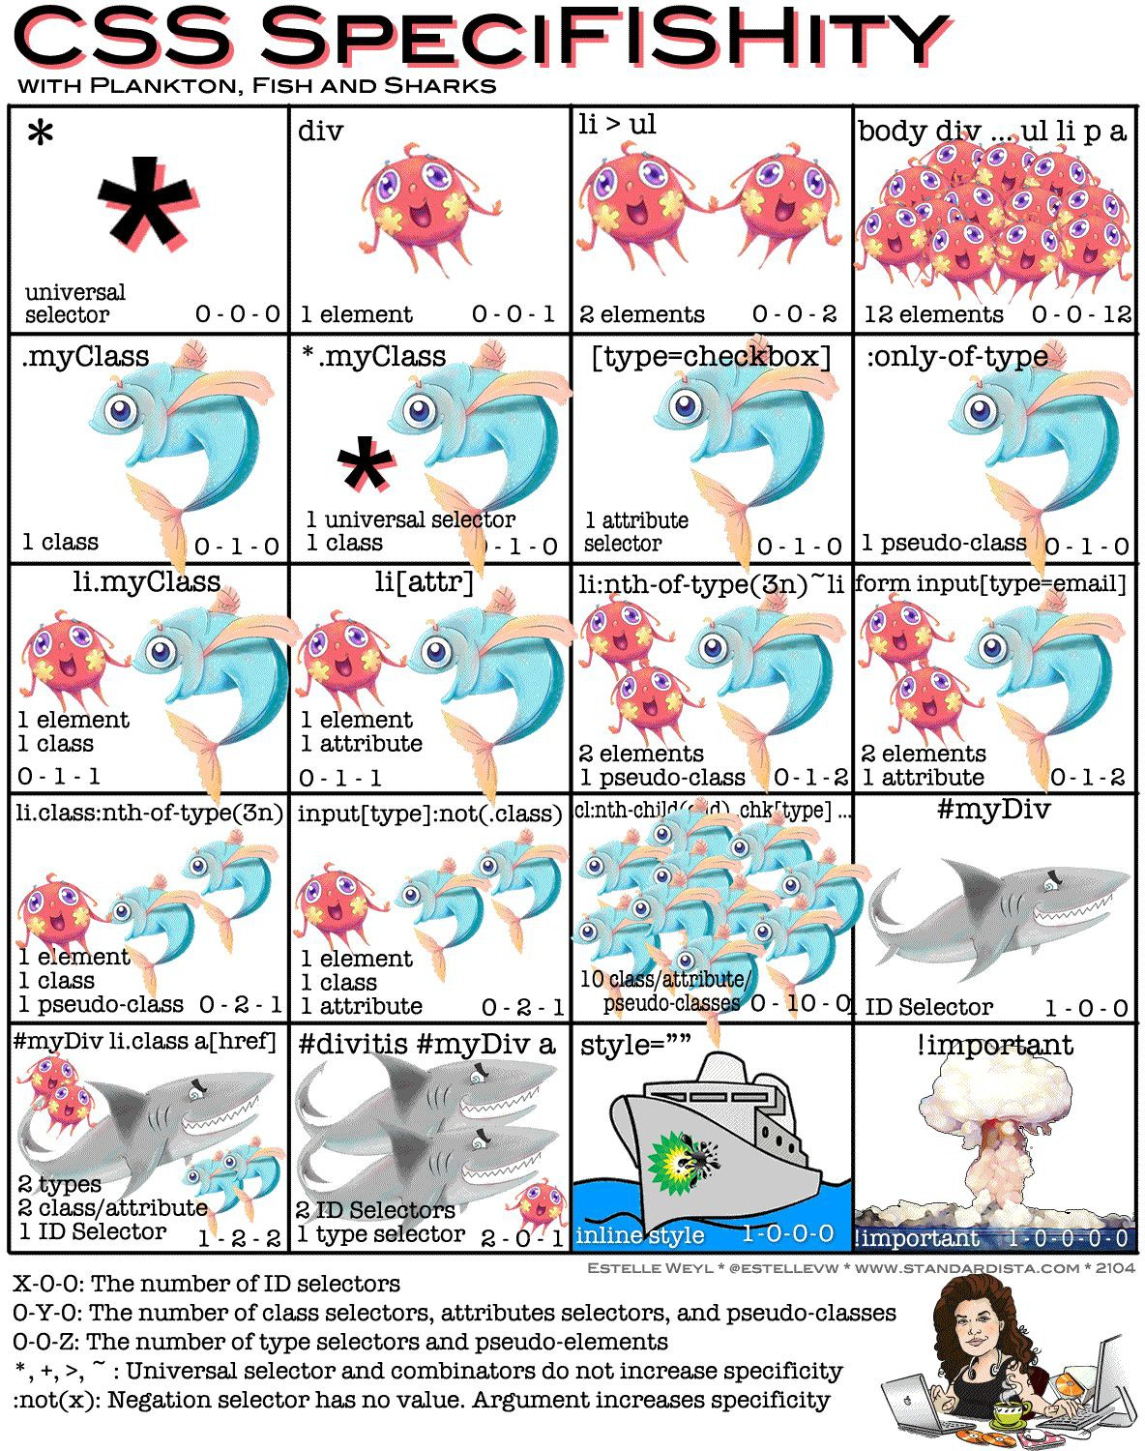

Slide 11

Let’s have an interim break

Slide 12
@rules (at-rules)
@rules are CSS statements that start with an at sign @ followed by an identiﬁer. They can be used for metadata e.g. @charset, descriptive information e.g. @font-face and conditional logic e.g. @media queries.
@media queries are another way of making our content responsive: they query the media type to see if something is true ﬁrst and adjust accordingly.
As you see on the left, technically, there is also a 4th way to insert CSS - importing.
You can import an entire style sheet, or just a select few rules.
Be careful as it can affect the speed of your page. It must always go at the top.
@import url(‘https://fonts.googleapis.com/css?family=Muli&display=swap’); @import url("glossy.css") print;
@import url("textto.css") speech;
@import url('portrait.css') screen and (orientation:portrait);

Slide 13
Task 1: Diving deeper into our CSS
Create CSS rules with all 4 combinator selectors - who listens to elders and which siblings get along?
See if you can ﬁnd or make an element(s) have at least more than 1 rule. What has more speciﬁcity ?
@import a CSS stylesheet at the top - look up some examples online. What does it do and or add?
If you have time, you can also try to use @charset and
@font-face to see how they enhance things.

Slide 14
Intermission

Slide 15
CSS Flexbox
Flexible box - shortened to ﬂexbox, are 1D one-dimensional layout models, which means they display content either within a row or a column. Their purpose is to space out and automatically align items more ﬂexibly.
So when we lay things out with ﬂexbox, that element becomes a ﬂex container - the parent with its children inside. To do that, we put the value of the display property to ﬂex or inline-ﬂex.
There are two axes to consider: the main axis set by ﬂex-direction and the resulting cross axis perpendicular to it. Feel free to play around with this and look up other ﬂex properties. It’s a good one to have in your toolbox for easily arranging content.
<section class="box">
<img src… >
<img src… >
.box {
display: flex;
/* OR
display: inline-flex;
AND */
flex-direction:row;
/* OR
row-reverse OR column OR column-reverse; */
}
Notes:
Module – preset in CSS
Display content in a row or a column

Slide 16
Flexitime

Slide 17
Task 2: Check out how CSS ﬂexes
Create or choose 4 elements to turn into a ﬂex container. You can use the class attribute to identify an element as a ﬂexbox or just use the display property on any of them with the property values set accordingly. Make 2 of them inline.
Ensure that you have at least 3 children within each
parent - you might ﬁnd that images work best.
Test out assigning each of the different ﬂex directions. Does this save you time? See if you can create interesting shapes e.g. a T shape on its side.

Slide 18
CSS Grids
Grids are created in a way similar to ﬂexboxes, but are 2D instead: they handle two dimensions. This makes them the most powerful layout system (for now) and more convenient than others options.
First, we set a container element as a grid using the display property as before. Then we deﬁne the measurements for our rows and columns. If we simply decide values, the automatic lines names are 1, 2, 3, 4, 5 …
We can choose names for them according to a syntax : [linename] size [linename] size
...
<section class="grid-container">
<div class="grid-item">item1</div>
<div class="grid-item">item2</div>
.grid-container {
display: grid; /* OR inline-grid; */
grid-template-columns: 25px auto 50% grid-template-rows: auto auto auto
grid-template-columns: [c1] 25px [2nd] auto [3] 50% grid-template-rows: [row1-start] 33% [row1-end] 00px

Slide 19
Break

Slide 20
Task 3: Upgrading via grids for CSS
Show what you’re working on to the people in your group if you can and are comfortable doing so. Ask for their feedback on where it could be useful for you to put use (a) grid(s), in addition to ﬂexbox containers.
Aim to get your portfolio to at least a semi-ﬁnished stage, as next time we’ll start building a bookshop site. You can take inspiration from the ideas I’ll show you or keep researching for your own distinct style ;) !

Slide 21
Any questions?
Copyright © 2020 Black Codher Bootcamp. All Rights Reserved. Do Not Redistribute.

Slide 22
Well done! Get some rest and see you soon!
Copyright © 2020 Black Codher Bootcamp. All Rights Reserved. Do Not Redistribute.

